Slide 1

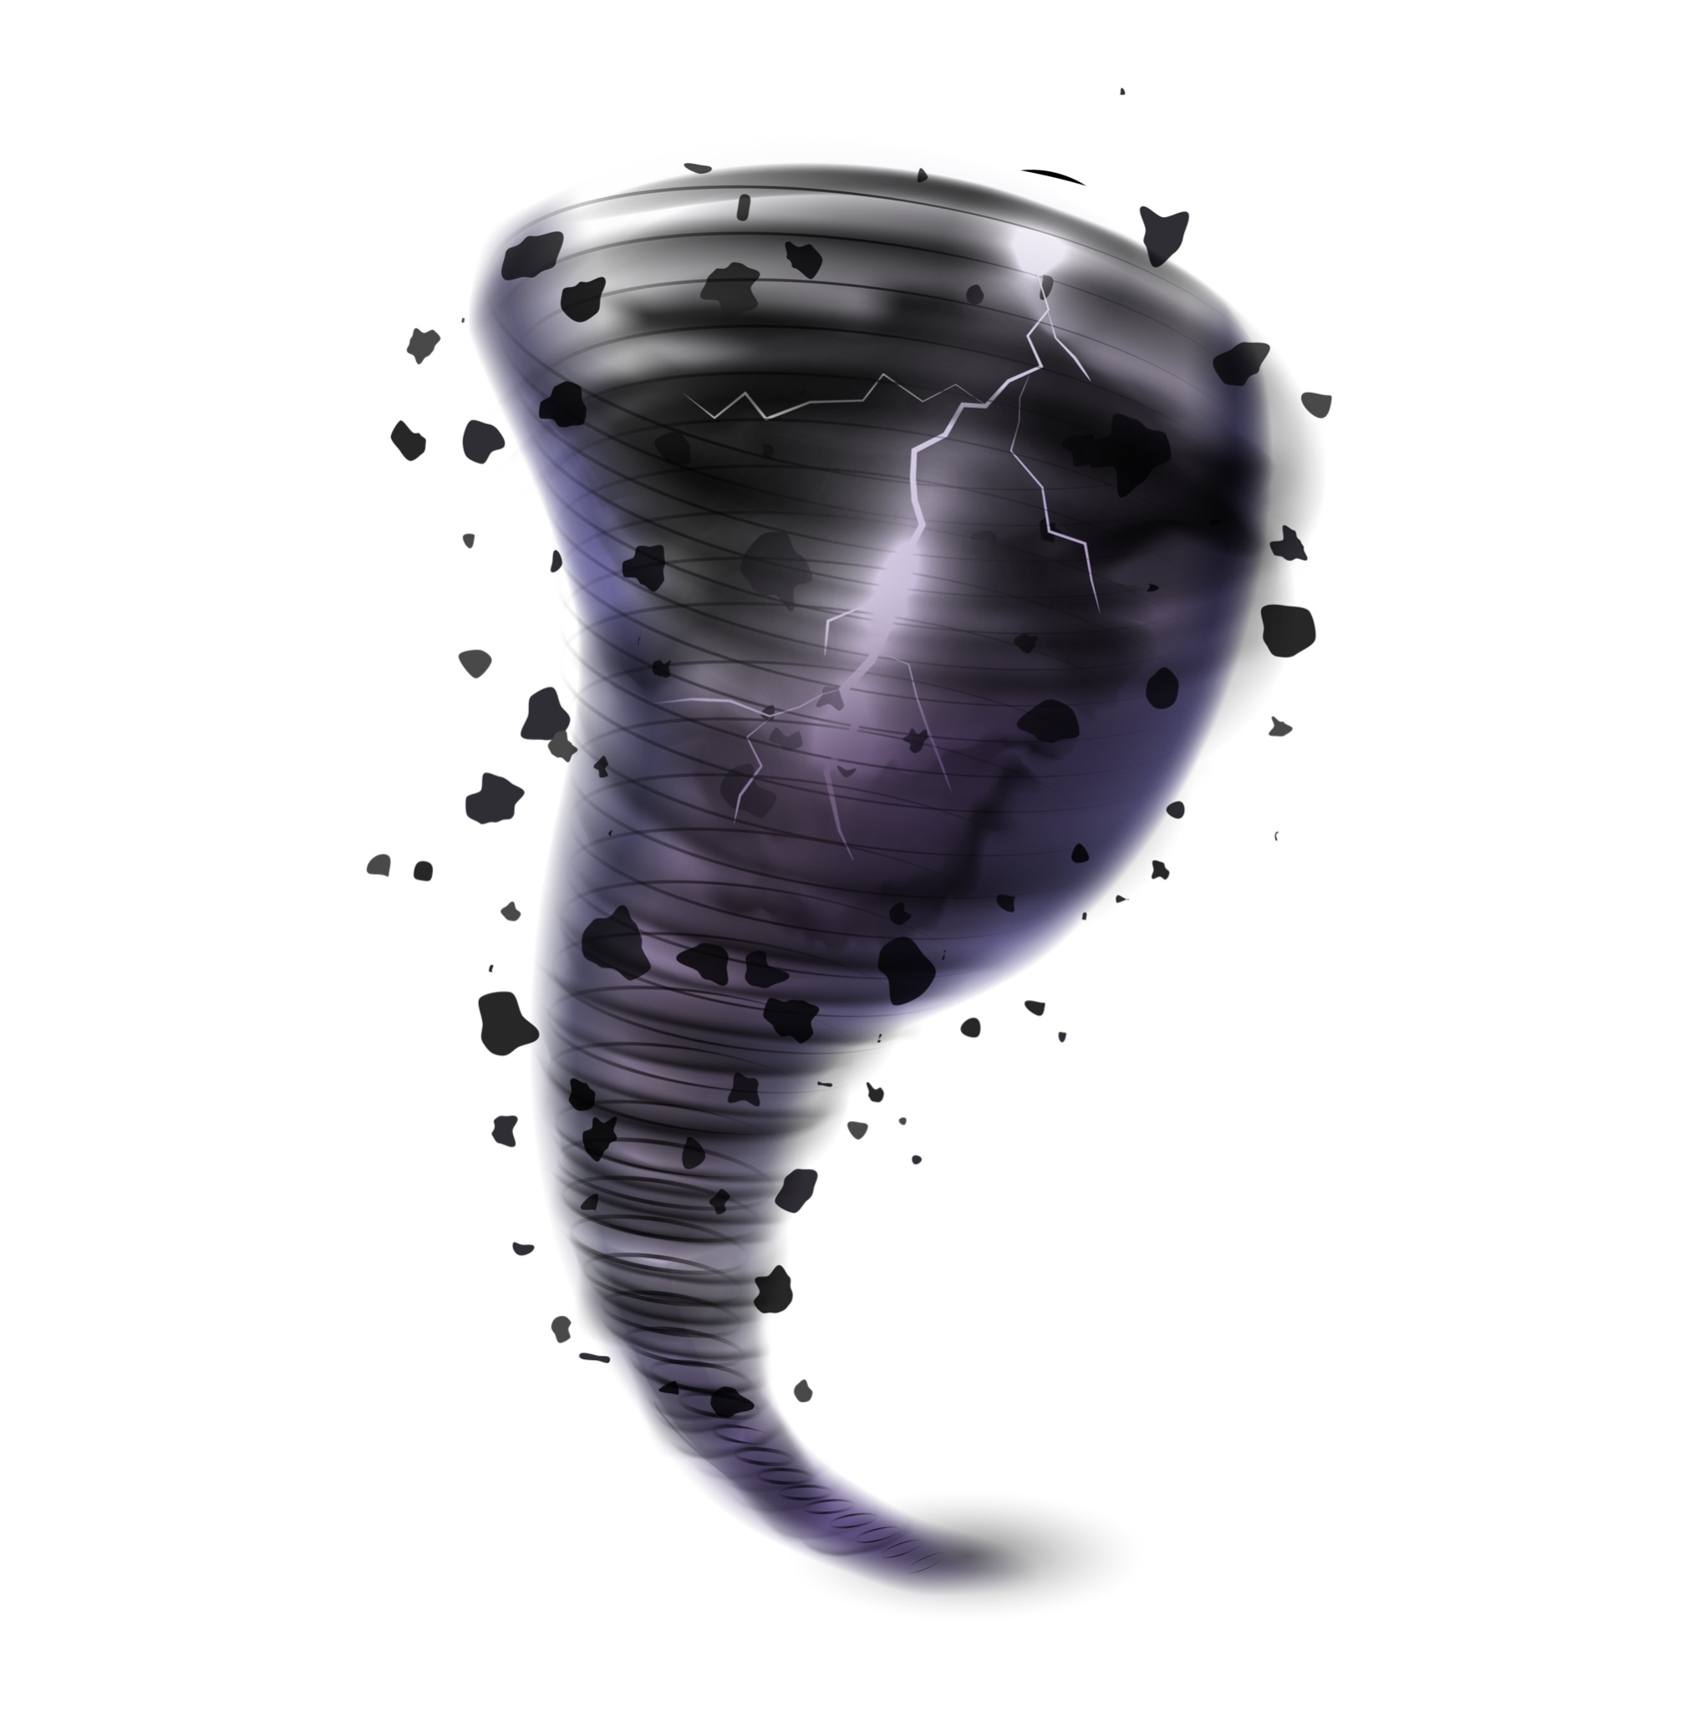
SNRL TORNADO-Q CHALLENGE - TEAM 17
Andrew Maciejunes, Jesse Webb, Andrew Norway, Vlad Gaylun
October 11, 2025

Slide 2

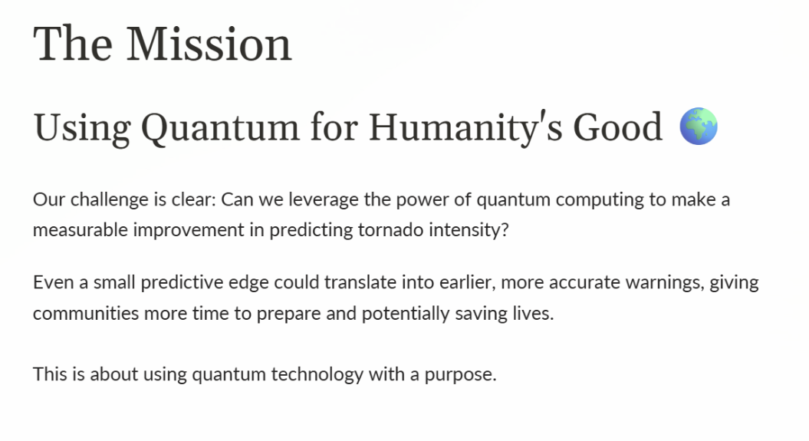

Slide 3
GOAL
Predict tornadoes class from atmospheric features, demonstrate a measurable lift from a quantum/hybrid approach over strong classical baselines

Slide 4
Major Challenges
DATA PREPROCESSING & FEATURE STRATEGY
CLASSICAL & HYBRID BASELINE
QUANTUM MODEL
How can we find creative solutions to a challenging dataset?

Slide 5
Our Approach
DATASET
Missing Features
Normalization
Imbalanced Classes
CLASSICAL Methods
Build off known models
Into Hybrid feature Encodings
QUANTUM
PQCs
Random Shadowing
Post-Prediction w/ Kernel Est.
Mixing classical and quantum standards with novel ideas.

Slide 6

METRICS TO OPTIMIZE
What and Why:
ROC-AUC: sanity-check overall separability across thresholds
Recall (strong EF2+): minimize missed dangerous events (False Negatives)
Precision (strong): reduce over-alerting so emergency resources aren’t diluted.
Operational playbook for emergency navigation (score → action)
Tier 0 – Monitor: score < T1 → continue monitoring; no public alert
Tier 1 – Watch: T1 ≤ score < T2 → notify internal ops; pre-stage responders
Tier 2 – Warning (High Risk): score ≥ T2 OR rapid score increase → public alert, activate sirens, open shelters per SOP
Notes:
Things we tried:
Critical Success Index

Slide 7
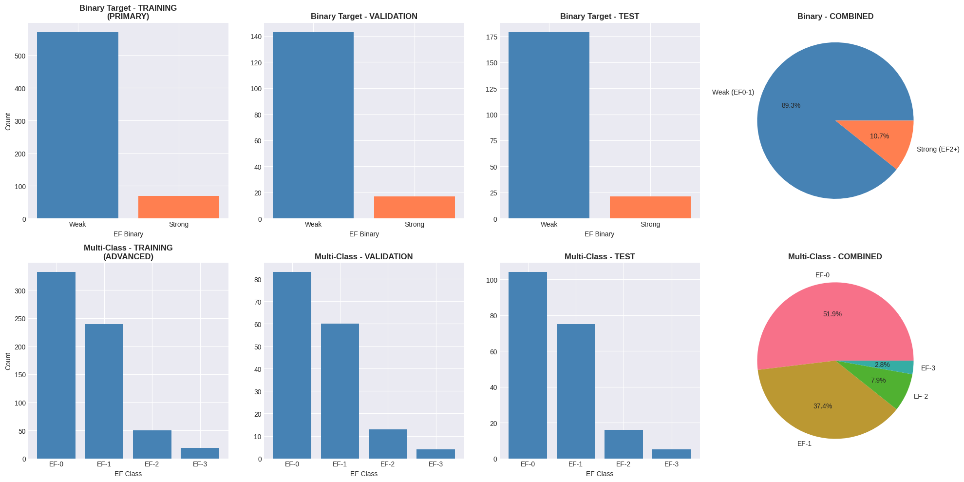
DATA PREPROCESSING & FEATURE STRATEGY
The dataset shows imbalance between weak (EF0-1) and strong (EF2+) tornadoes, and the decision boundary between them is probably not clean-cut - there's a "gray zone" where features overlap. BorderlineSMOTE strategically generates synthetic examples exactly where the model needs them most: at the decision boundary.

Slide 8
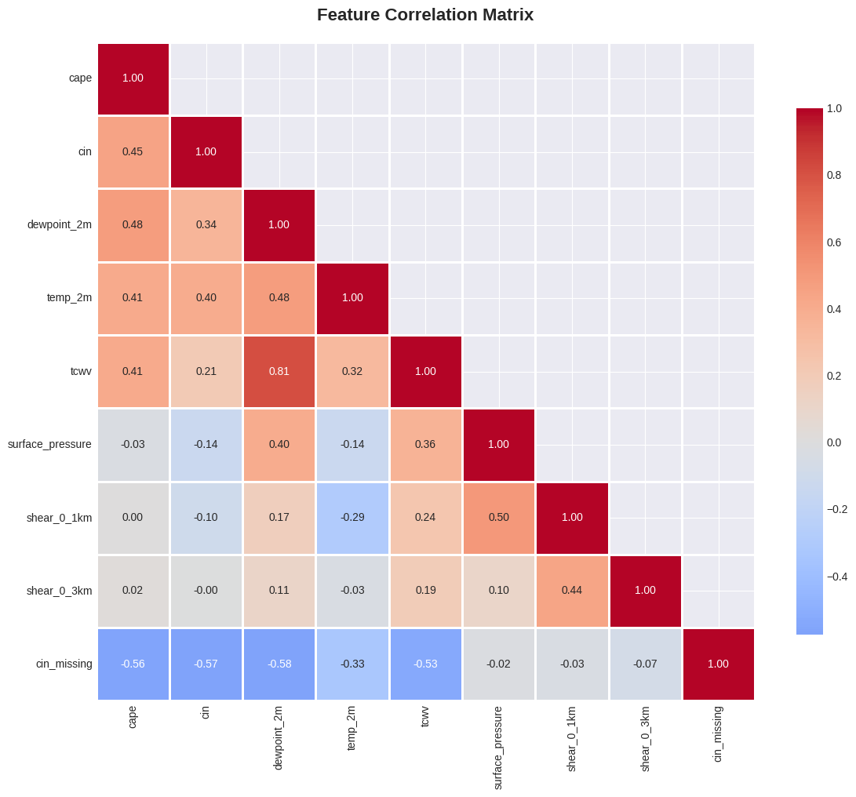
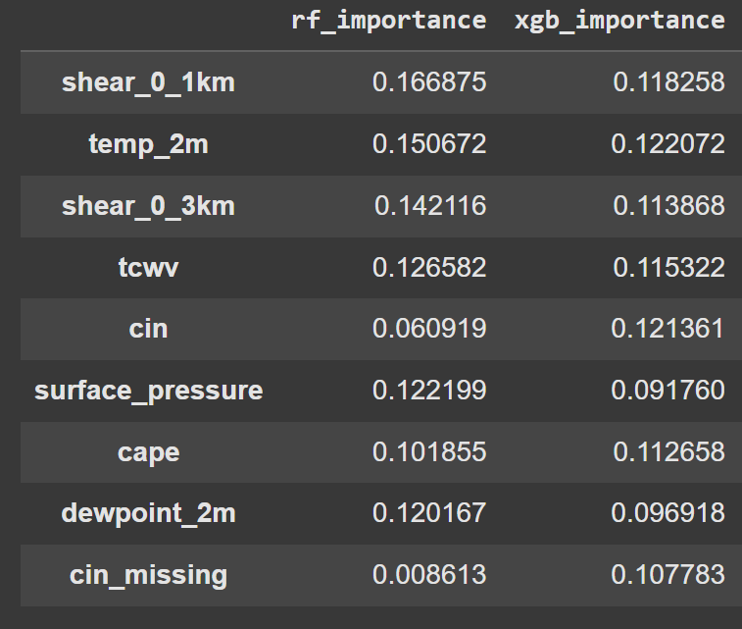
DATA PREPROCESSING & FEATURE STRATEGY
The dataset shows imbalance between weak (EF0-1) and strong (EF2+) tornadoes, and the decision boundary between them is probably not clean-cut - there's a "gray zone" where features overlap. BorderlineSMOTE strategically generates synthetic examples exactly where the model needs them most: at the decision boundary.
Targets: ef_binary (primary), ef_class (stretch goal)
Scaling: Min–Max to [0,1]
Physics‑aware CIN imputation: if CAPE≈0 → set CIN=0; else fill CIN with train median
Class imbalance: BorderlineSMOTE
Feature selection: rank by
RF/XGB importance

Slide 9
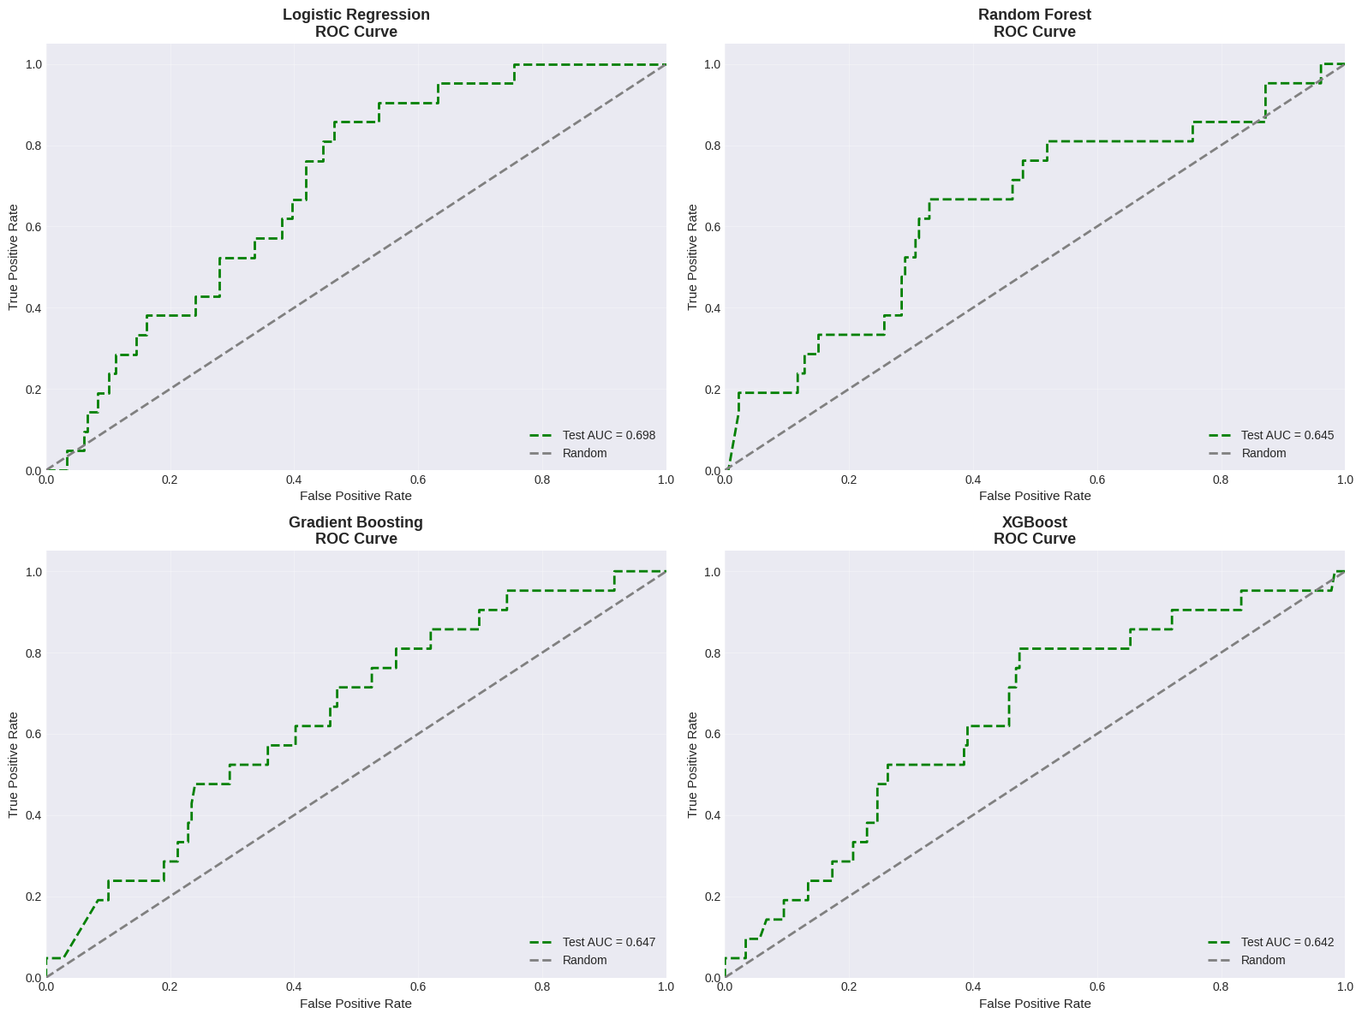
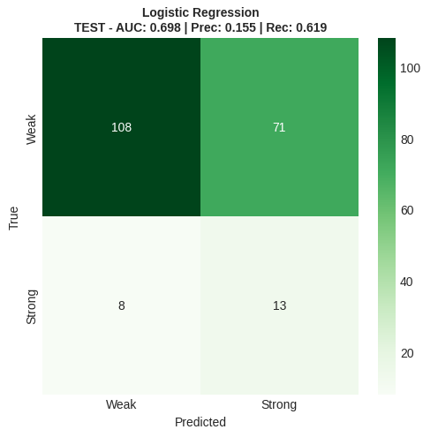
CLASSICAL BASELINE

Slide 10
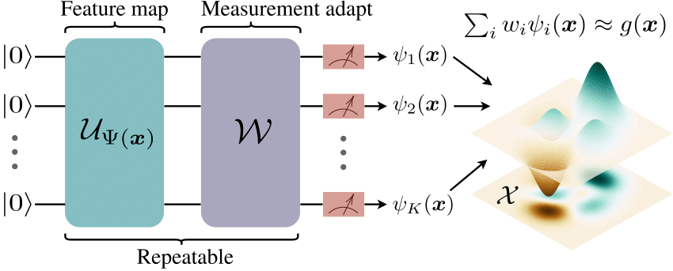
HYBRID BASELINE
Random shadow feature feature mapping into classical DNN
From 8 features to 36

Slide 11
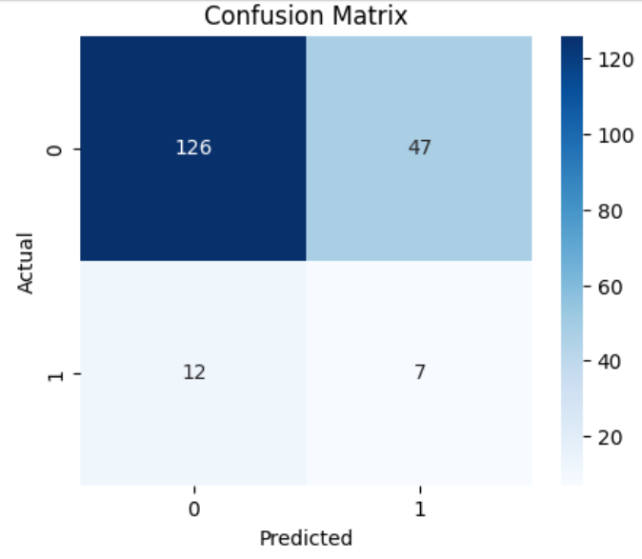
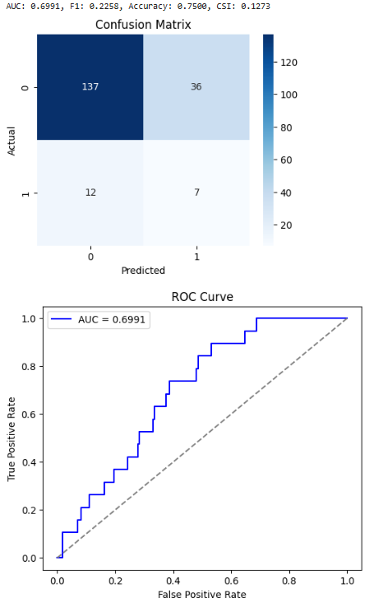
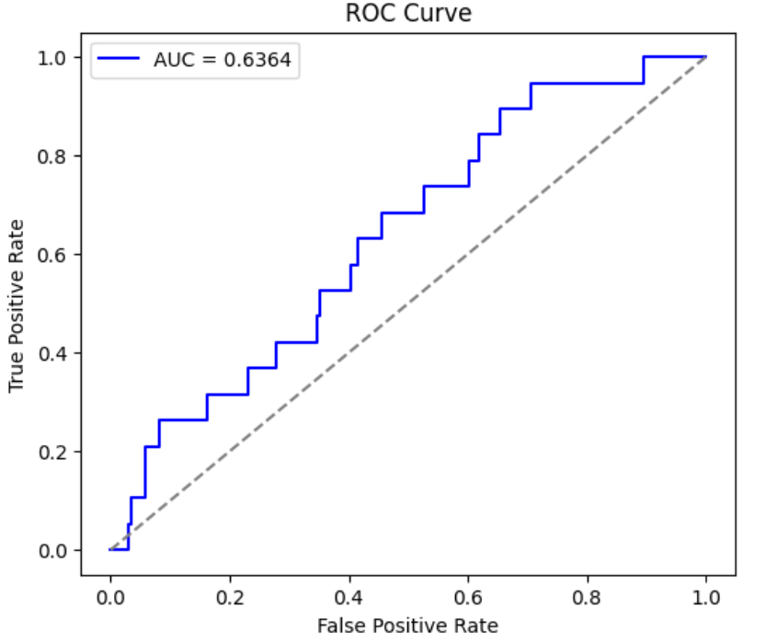
HYBRID BASELINE
Focus - boost AUC. Managed to get from 0.6364 to 0.6991 for DNN

Slide 12
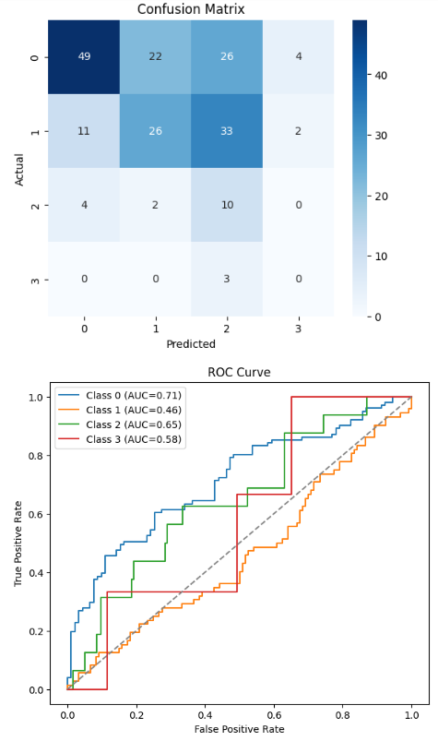
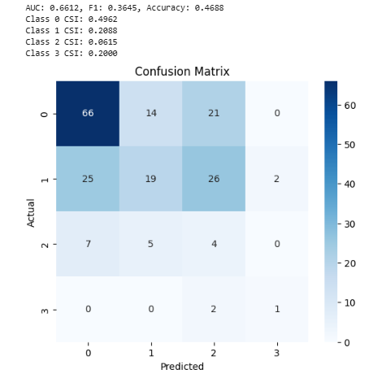
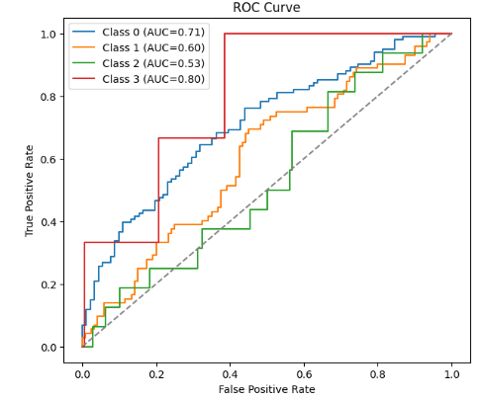
HYBRID BASELINE
Focus - detect EF-3 with high accuracy. We got AUC 0.80 for EF-3

Slide 13
QUANTUM MODEL
Encoding: Angle encoding (RX) of selected features; optional pairwise ZZ entanglement
Ansatz: shallow hardware‑efficient layers (L=2–3) to control noise and overfitting
Backends: PennyLane/Qiskit simulators; gradient‑based optimizer (Adam/COBYLA)
Hybrid: Quantum feature embedding in Random Layer and Strongly Entangled circuits → fed to a classical classifier
Additional Post-Processing: Quantum kernel (ZZFeatureMap) with classical SVM when feasible

Slide 14
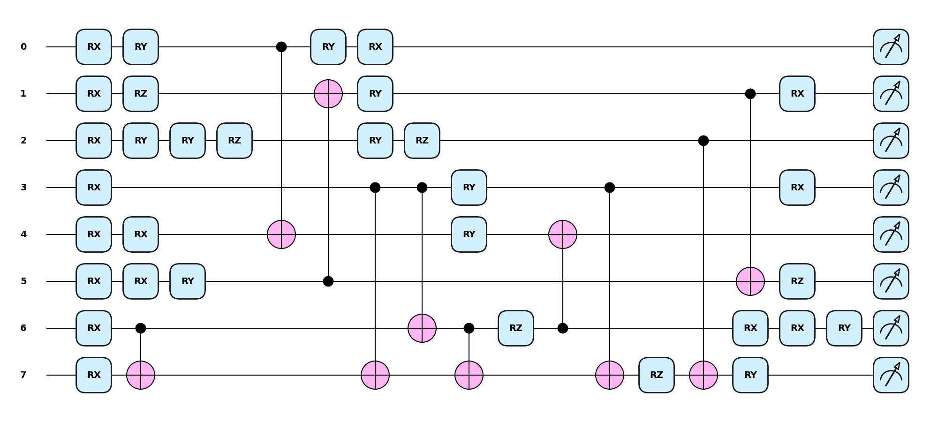
QUANTUM MODEL - PQC

Slide 15
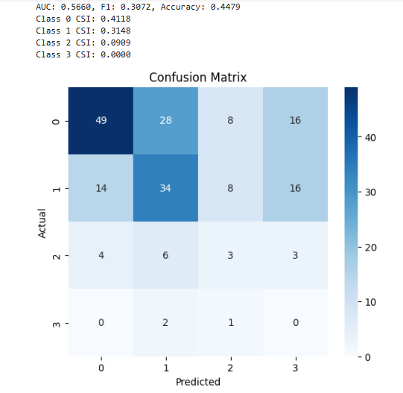
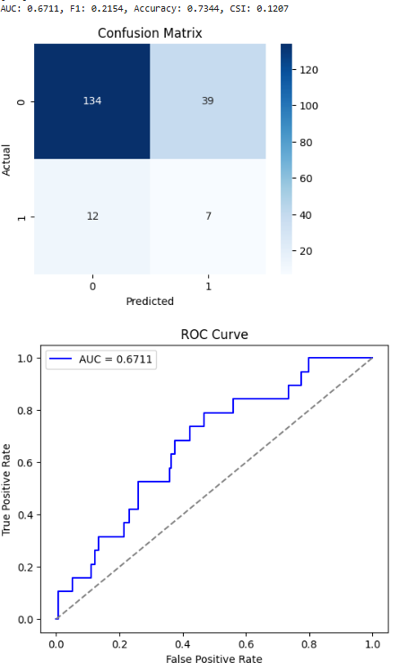
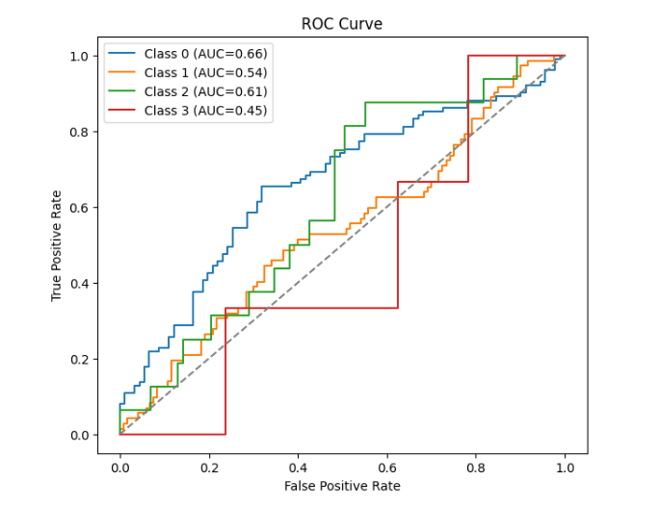
QUANTUM MODEL - PQC
Multiclass strongly entangled
RandomLayer 16 parameter binary
from 0.6364 to 0.6711
We ran out of credits, but still have a decent result

Slide 16
Challenges and Approaches
Limited Training Data:
Problem Specific Feature Mapping
Based off covariance
Small Feature Space
Quantum Feature Engineering
Parameterized Entanglement
Highest Expressivity
Incomplete Data
Smote
Feature Refactoring
Quantum Kernel Estimation
Ran out of time :(
Nested Binary Classification

Slide 17
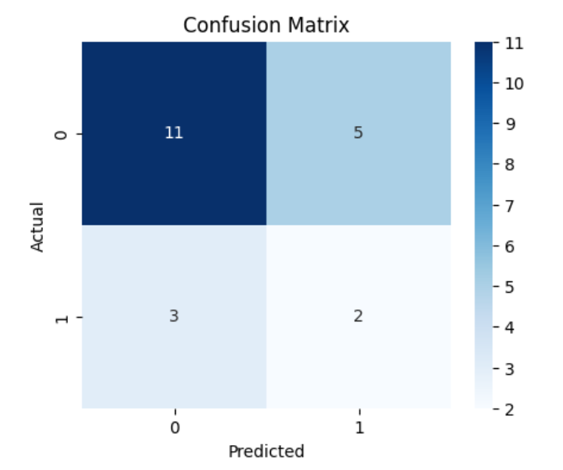
QUANTUM KERNEL ESTIMATION
Focus - Distinguish between EF2 and EF3 Tornadoes without Overfitting
Trained a quantum kernel on dataset of only EF2 and EF3 Tornadoes
Tried quantum SVC but had to find another approach
Contemplated Classical Quantifiers (Kernelized Logistic Regression, etc)
Tested SVM- but then got hit by a one-in-a-thousand year storm

Slide 18
How to
Use it

Slide 19
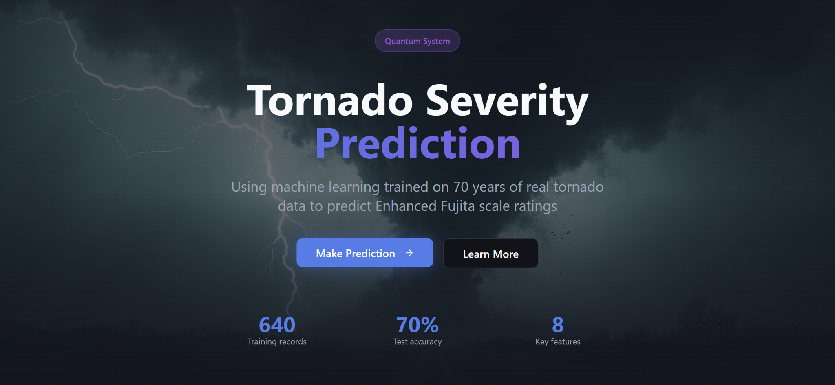
https://bit.ly/SC-hack-team17

Slide 20

THANKS

